Slide 1

Introduction to Machine Learning with

Slide 2
Libraries
Numpy
Pandas
MatplotLib
Scikit-Learn

Slide 3
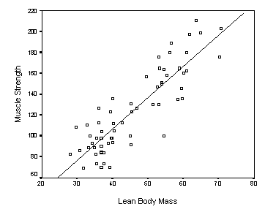
Linear Regression
ওজন
গায়ের জোড়
Golam 70Kg 200
Saddam 60Kg 100
Nur 40Kg 5
Liton 55Kg ?
Notes:
How LogisticRegression work. Minimization of loss.

Slide 4
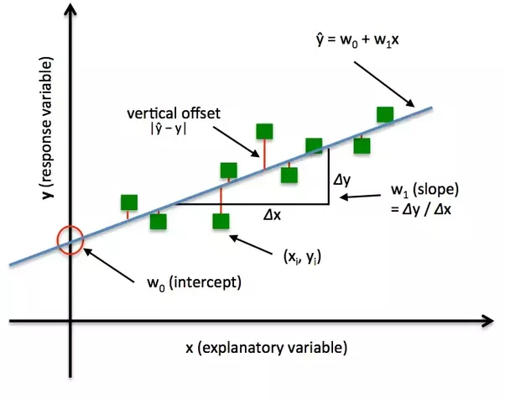
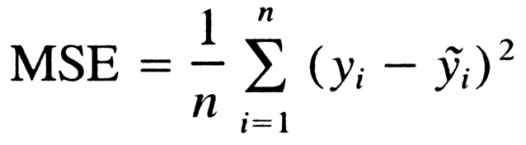
Loss

Slide 5
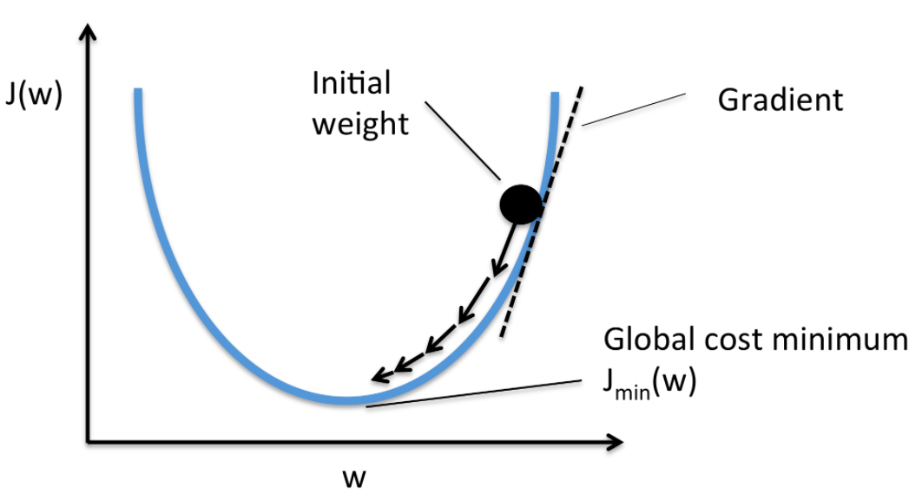
Error vs weight/intercept
m
b

Slide 6


Optimizer
Adams
Adagrad
Particle Swarm
Gradient Decent
$$new_{m}=old_{m} − α . \frac{δ}{δm}MSE$$
$$new_{b}=old_{b} − α . \frac{δ}{δb}MSE$$

Slide 7
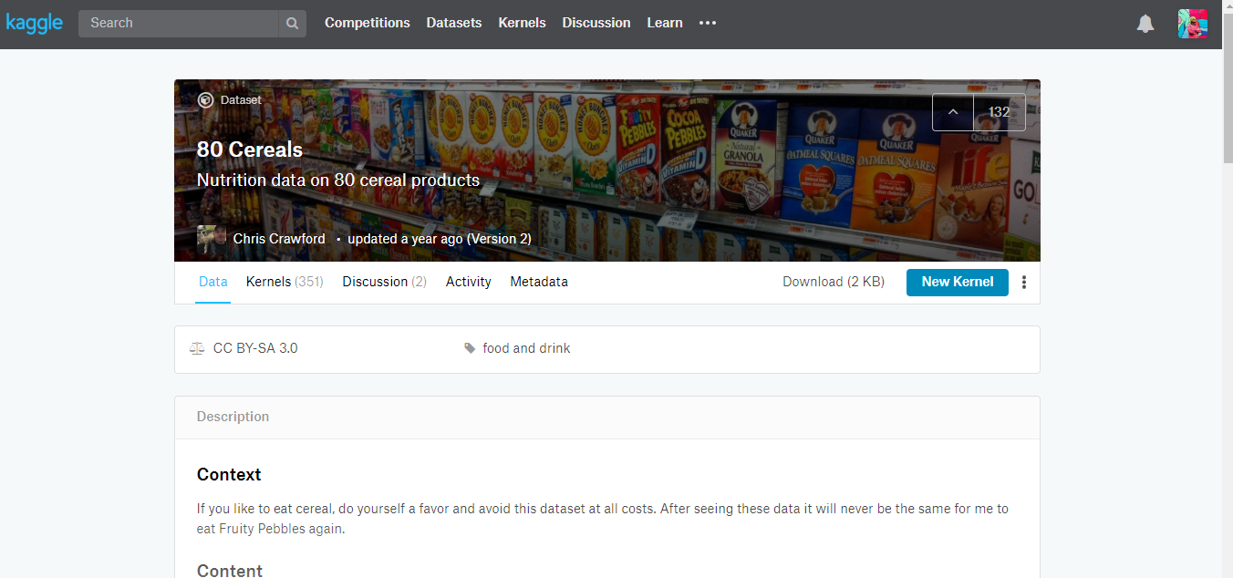
Notebook Demo

Slide 8
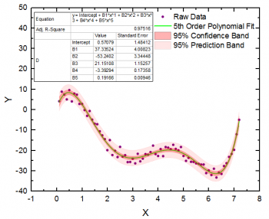
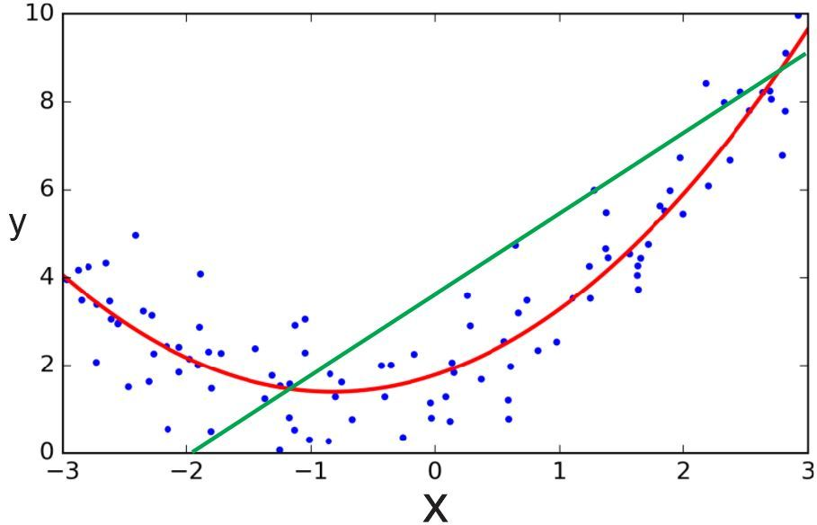
Polynomial Regression

Slide 9
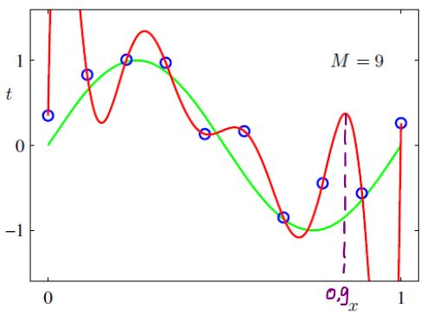
Bad Idea

Slide 10
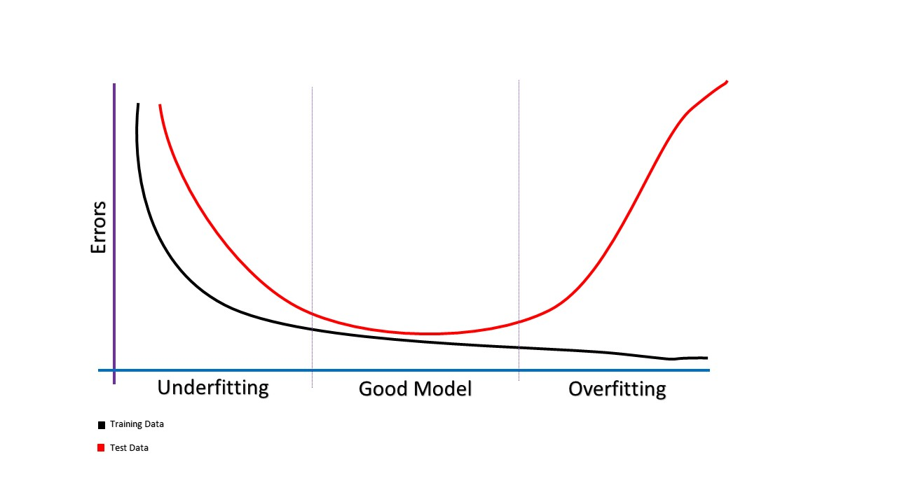
Underfit & Overfit
Degree of Complexity →

Slide 11
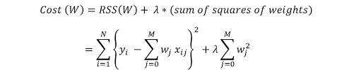
Solution?
Regularization
Penalize coefficients which cause overfitting in the loss function
Loss
MSE
Ridge Regression

Slide 12
Notebook Demo Ridge Regularization

Slide 13
Regularization types
Ridge
Lasso
Elastic Net

Slide 14
Train-test-split why we do this?
To test how our model performs prediction on data which it has never seen before
Usually we select test size around 20%-40% of our data set depending on number of Data.
Another way to train and test
N-fold Cross validation!!!

Slide 15
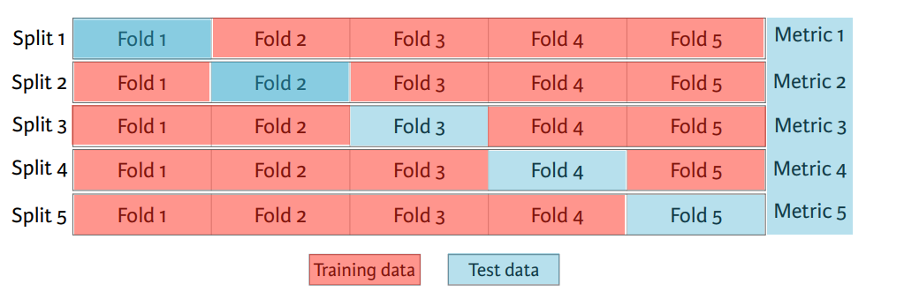
N-fold Cross validation!!!

Slide 16
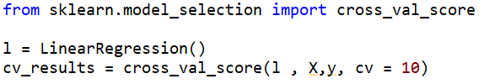

Slide 17
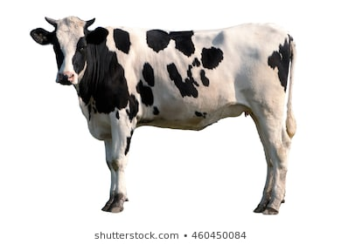
Classification
Predict Discrete classes
Example:
Cow?
1
Classifier
Notes:
Dhori amader ekta classifier goru kina eta check kore just

Slide 18
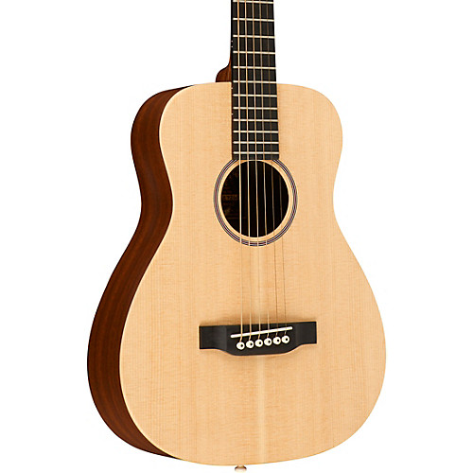
Classification
Predict Discrete classes
Example:
Cow?
0
Classifier

Slide 19
Classification
Predict Discrete classes
Example:
Cow?
0.89
Classifier
89% probability
of being a cow
Notes:
Dhori amader ekta classifier goru kina eta check kore just

Slide 20
Classification
Predict Discrete classes
Example:
Cow?
0.05
Classifier
5% probability
of being a cow

Slide 21

Classification
Multiclass Classfication
Class?
5
Classifier

Slide 22

Classification
Multiclass Classfication
Class?
3
Classifier

Slide 23
Classification
Actually given as
Classifier 0
0.0001
0.002
0.006
0.89
0.004
0.00003
0.001
0.005
0.09
0.002
Classifier 1
Classifier 2
Classifier 3
Highest Probability
Classifier 4
Classifier 5
Classifier 6
Classifier 7
Classifier 8
Classifier 9

Slide 24
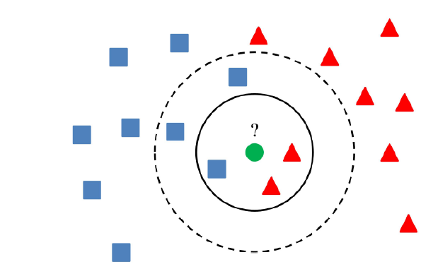
Classification Models
Knearest Neighbor Classifier

Slide 25
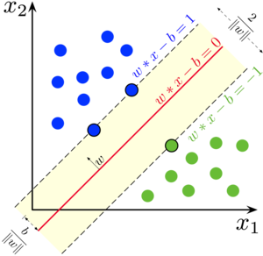
Classification Models
Support Vector
Machine

Slide 26
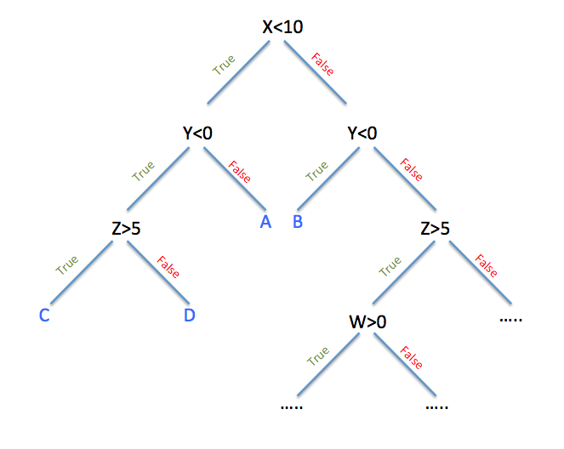
Decision Tree Classifier

Slide 27
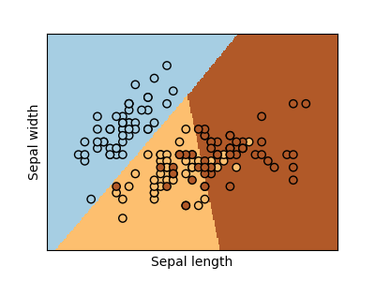
Logistic Regression

Slide 28

Underlying Math
$$y=m_{1}x_{1}+m_{2}x_{2}+…+m_{n}x_{n}+b$$
With an activation
$prediction=sigmoid \left(y\right)$
$$sigmoid \left(y\right)=\frac{1}{1+e^{−y}}$$
or $prediction=relu \left(y\right)$

Slide 29
Notebook Demo

Slide 30
Hyper Parameter Tuning
Logistic Regression -> α
SVM -> c , λ
K Neighbor Classifier -> k How to chose these values correctly?

Slide 31
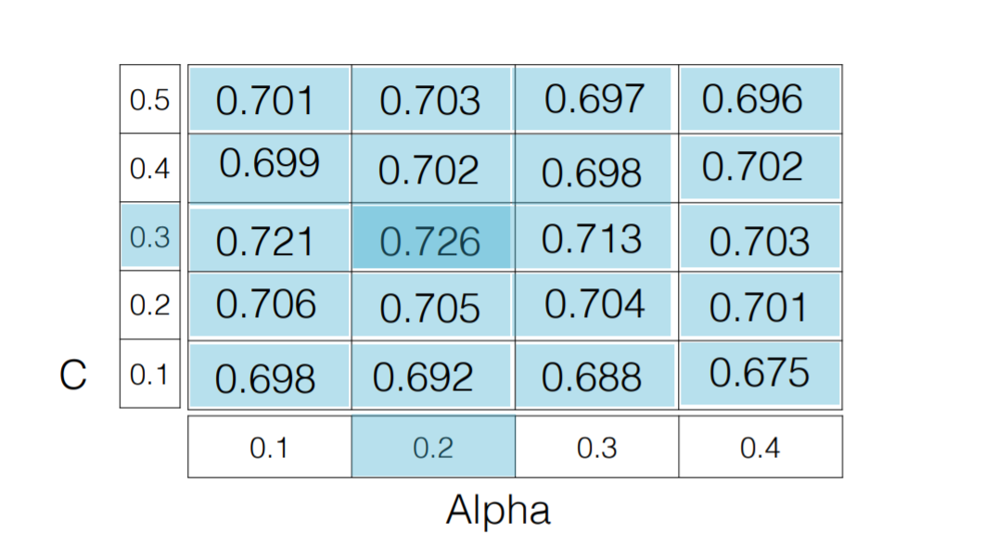
Try different values from intuition
Its like tuning a PID controller.
Or tell the model to try different things by itself
For this we use GridSearch

Slide 32
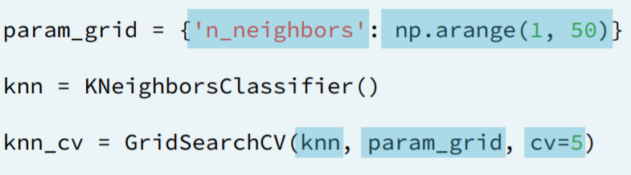
GridSearch Lets try it on Kneighbor Classifier
We have to specify here, number of neighbors to search for.
From sklearn.model_selection import GridSearchCV

Slide 33
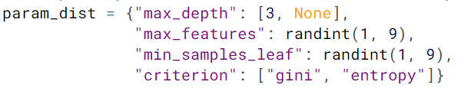

Decision Tree Classifier

Slide 34
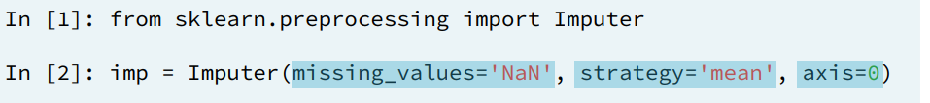

Some Preprocessing of Data
Imputation It fixes dataset by filling empty data
median
most_frequent

Slide 35
Some Preprocessing of Data
Scaling Scales data to zero mean and 1 SD for easy fitting
Scalar = StandardScaler()

Slide 36

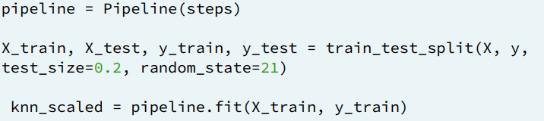
Pipelining
Workflow with the data
From sklearn.pipeline import Pipeline

Slide 37


GridSearch and pipelining
pipelineStep _ _ parametername

Slide 38
Demo

Slide 39

How good is my model
Confusion Matrix
Accuracy (RMSE, $R^{2}$ test) -> not always the best answer
Classification Report
Precision
Recall
F1-Score

Slide 40
শ্যাষ

